Slide 1

ECE 281 Lesson 35
1

Slide 2
Lesson 35 Outline
Do Time Logs!
Lab 4 Mega PreLab – Due Now
Lab 4 Demo – Lesson 38
GR #3 – Lesson 39
Lab 4 Report and Final Review – Lesson 40
FYI, All assigned work is required for completion of the course. Even if an assignment is so late that no credit will be received, the assignment must be completed to the satisfaction of your instruction to prevent an “incomplete” grade. Must be complete by COB Lesson 40.

Slide 3
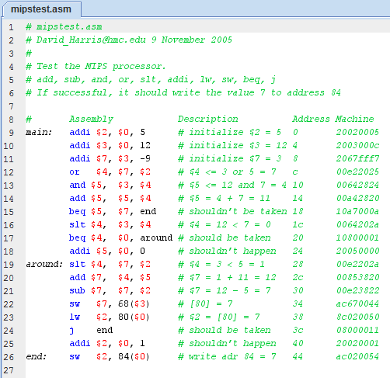
Getting the right machine code from MARS…

Slide 4
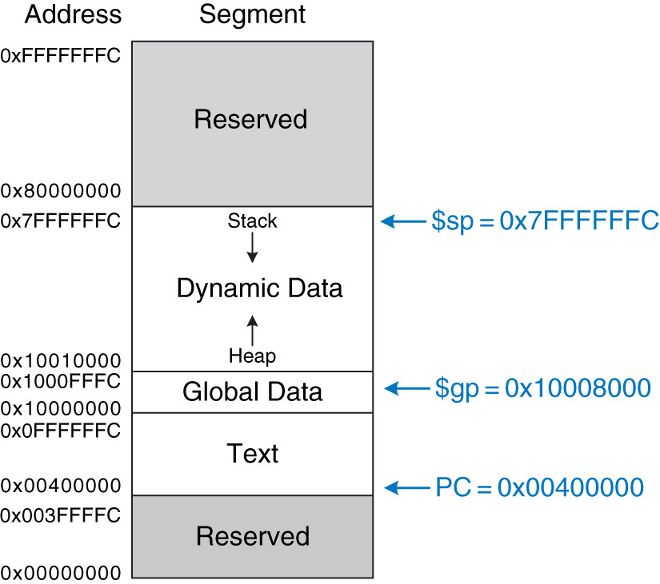
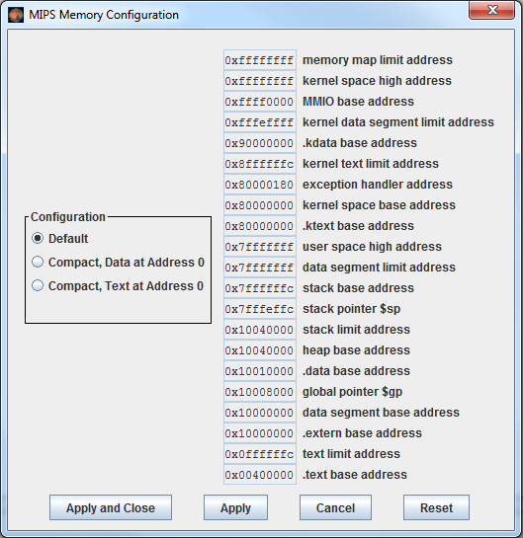
Default MIPS Memory Map
MARS Settings → Memory Configuration
Figure 6.31 MIPS memory map
Copyright © 2013 Elsevier Inc. All rights reserved.

Slide 5
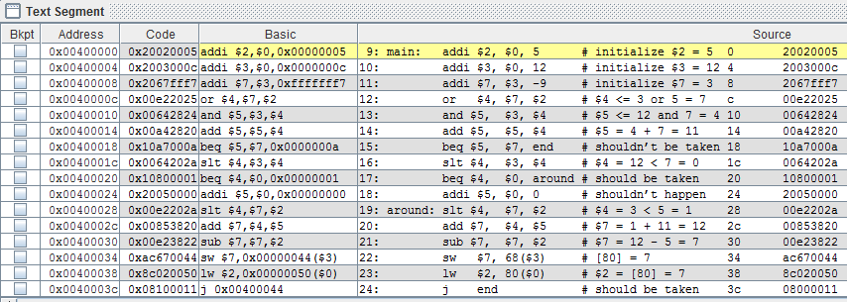
Using Default Memory Map
Jump instructions do not point to the correct address!

Slide 6
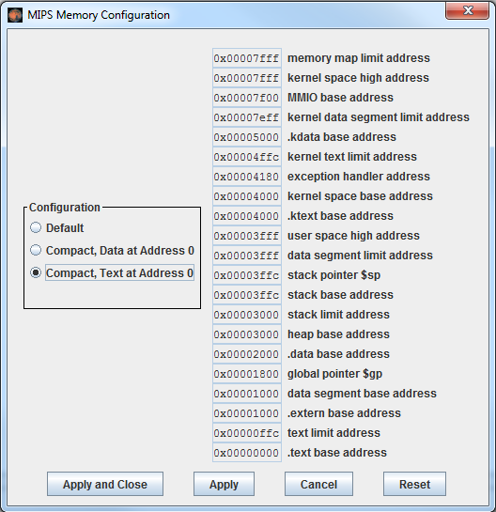
Change MARS Memory Settings

Slide 7
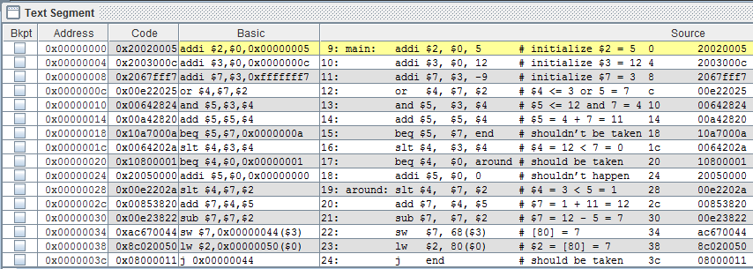
Using Compact Memory Map
Jump instructions now point to the correct address!

Slide 8
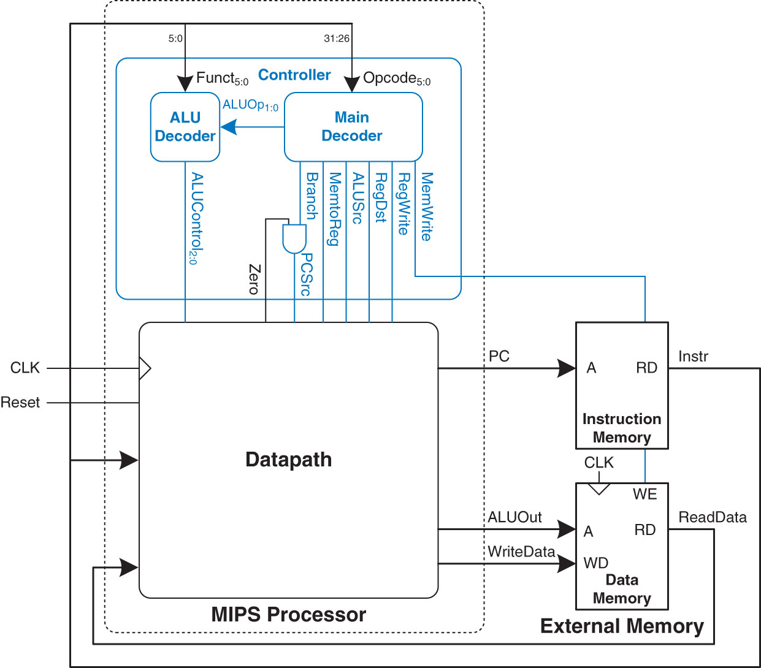
MIPS Single Cycle Processor
for Lab 4
Figure 7.59 MIPS single-cycle processor interfaced to external memory
Copyright © 2013 Elsevier Inc. All rights reserved.

Slide 9
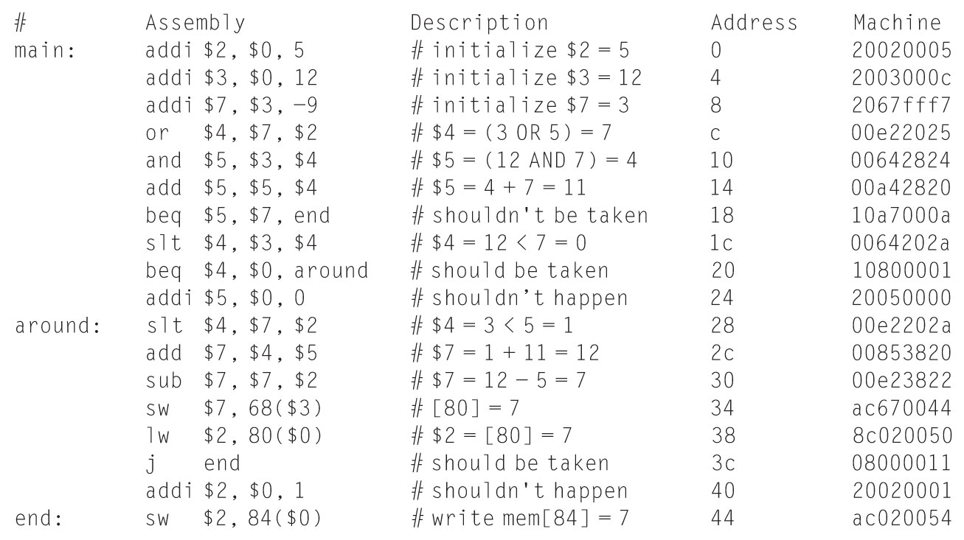
MIPS Test Program
mipstest.asm
Figure 7.60 Assembly and machine code for MIPS test program
Copyright © 2013 Elsevier Inc. All rights reserved.

Slide 10
Table 1 - First sixteen cycles of executing lab4_mipstest.asm
Cycle | reset | pc | instr | branch | src_a | src_b | alu_result | zero | pc_src | write_data | mem_write | read_data
1 | 1 | 00 | addi $2,$0,5 20020005 | 0 | 0 | 5 | 5 | 0 | 0 | 0 | 0 | x
2 | 0 | 04 | addi $3,$0,12 2003000c | 0 | 0 | c | c | 0 | 0 | 0 | 0 | x
3 | 0 | 08 | addi $7,$3,-9 2067fff7 | 0 | c | -9 | 3 | 0 | 0 | 0 | 0 | x
4 | 0 | 0C
5
6
7
8
9
10
11
12
13
14
15
16

Slide 11
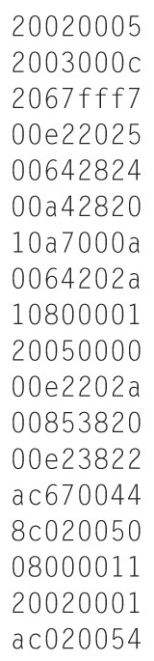
Contents of memfile.dat
Figure 7.61 Contents of memfile.dat
Copyright © 2013 Elsevier Inc. All rights reserved.

Slide 12
ALUOp Encoding
alu_op_{1:0} | Meaning
00 | Add
01 | Subtract
10 | Look at Funct field
11 | not used
Table 7.1 ALUOp encoding
Copyright © 2013 Elsevier Inc. All rights reserved.

Slide 13
ALU Decoder Truth Table
alu_op_{1:0} | Funct_{5:0} | ALUControl_{2:0}
00 | X | 010 (add)
X1 | X | 110 (subtract)
1X | 100000 (Add) | 010 (add)
1X | 100010 (sub) | 110 (subtract)
1X | 100100 (and) | 000 (and)
1X | 100101 (or) | 001 (or)
1X | 101010 (slt) | 111 (set less than)
Table 7.2 ALU decoder truth table
Copyright © 2013 Elsevier Inc. All rights reserved.

Slide 14
Main Decoder Truth Table
Instruction | Op_{5:0} | reg_write | reg_dst | alu_src | branch | mem_write | mem_to_reg | alu_op_{1:0} | Jump
R-type | 000000 | 1 | 1 | 0 | 0 | 0 | 0 | Look @ funct 10 | 0
lw | 100011 | 1 | 0 | 1 | 0 | 0 | 1 | imm + rs 00 | 0
sw | 101011 | 0 | X | 1 | 0 | 1 | X | imm + rs 00 | 0
beq | 000100 | 0 | X | 0 | 1 | 0 | X | sub 01 | 0
addi | 001000 | 1 | 0 | 1 | 0 | 0 | 0 | imm + rs 00 | 0
j | 000010 | 0 | X | X | X | 0 | X | XX | 1
ori | 001101
bne | 000101
Table 7.5 Main decoder truth table enhanced to support j
Copyright © 2013 Elsevier Inc. All rights reserved.

Slide 15
MIPS Single-Cycle Processor Schematic
Copyright © 2013 Elsevier Inc. All rights reserved.

Slide 17
I-Type Instructions
I-Type Instructions – Immediate Type
I-Type
op | rs | rt | imm
6 bits | 5 bits | 5 bits | 16 bits
I-Type
op | rs | rt | imm
6 bits | 5 bits | 5 bits | 16 bits
31:26 | 25:21 | 20:16 | 15:0

Slide 18
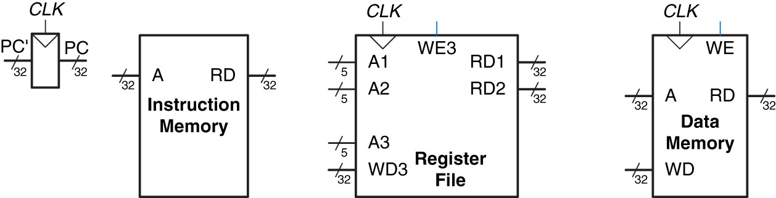
State Elements of MIPS
Processor
Instruction Memory – put in address get out data
Register File – can do two reads at once
A1 ➔ RD1 A2 ➔ RD2
A3 ➔ WD3 and is Controlled by WE
Data Memory – put in address, controlled by WE
Figure 7.1 State elements of MIPS processor
Copyright © 2013 Elsevier Inc. All rights reserved.

Slide 19
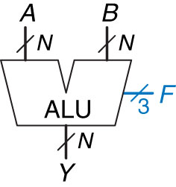
Arithmetic Logic Unit - ALU
F_{2:0} | Function
000 | A & B
001 | A | B
010 | A + B
011 | not used
100 | A & ~B
101 | A | ~B
110 | A - B
111 | SLT

Slide 20
I-Type Instruction lw rt, imm(rs)
I-Type
op | rs | rt | imm
6 bits | 5 bits | 5 bits | 16 bits
31:26 | 25:21 | 20:16 | 15:0

Slide 21
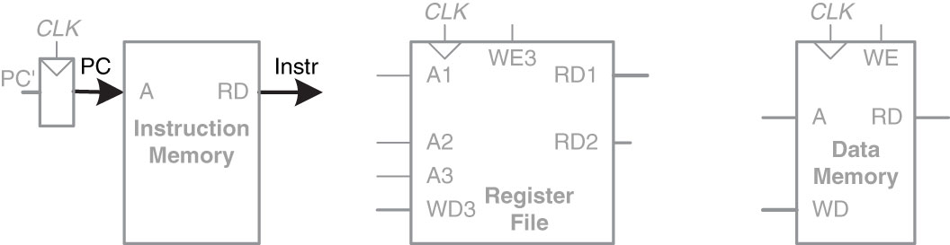
I-Type Instruction
lw rt, imm(rs)
Step 1:
I-Type
op | rs | rt | imm
6 bits | 5 bits | 5 bits | 16 bits
31:26 | 25:21 | 20:16 | 15:0
Figure 7.2 Fetch instruction from memory
Copyright © 2013 Elsevier Inc. All rights reserved.

Slide 22
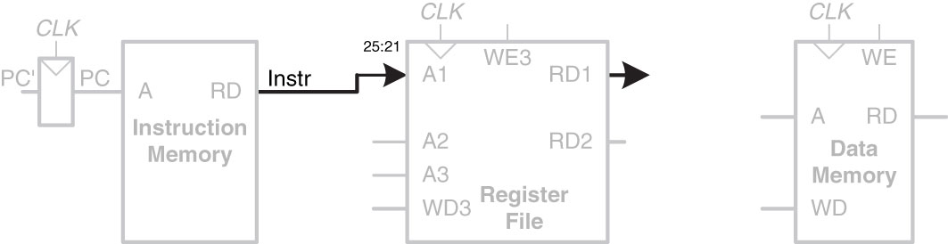
I-Type Instruction
lw rt, imm(rs)
Step 2:
Figure 7.3 Read source operand from register file
I-Type
op | rs | rt | imm
6 bits | 5 bits | 5 bits | 16 bits
31:26 | 25:21 | 20:16 | 15:0
Copyright © 2013 Elsevier Inc. All rights reserved.

Slide 23
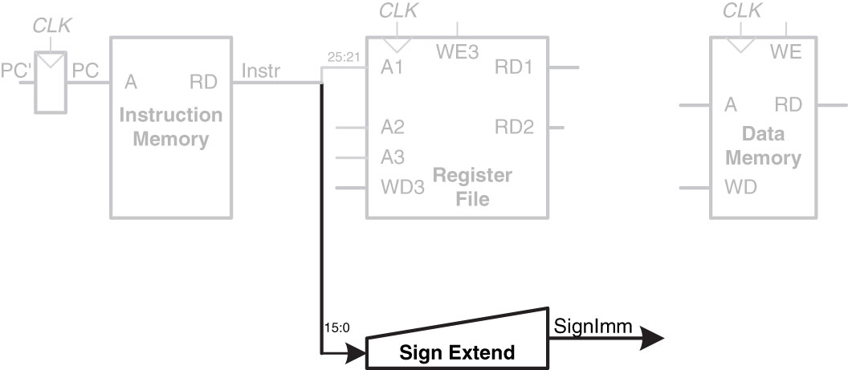
I-Type Instruction
lw rt, imm(rs)
I-Type
op | rs | rt | imm
6 bits | 5 bits | 5 bits | 16 bits
31:26 | 25:21 | 20:16 | 15:0
Step 3:
Figure 7.4 Sign-extend the immediate
Copyright © 2013 Elsevier Inc. All rights reserved.

Slide 24
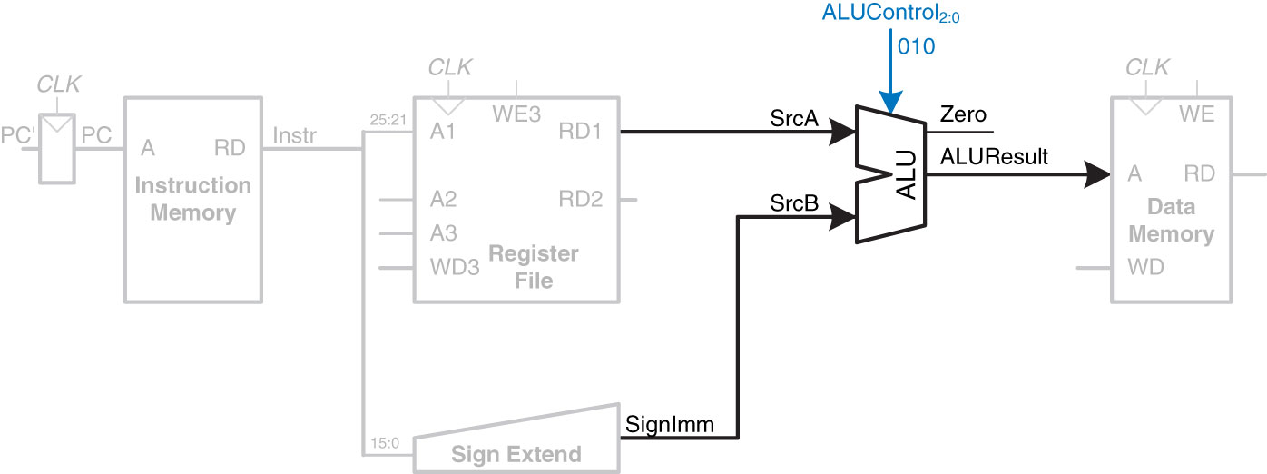
I-Type Instruction
lw rt, imm(rs)
Step 4:
I-Type
op | rs | rt | imm
6 bits | 5 bits | 5 bits | 16 bits
31:26 | 25:21 | 20:16 | 15:0
Figure 7.5 Compute memory address
Copyright © 2013 Elsevier Inc. All rights reserved.

Slide 25
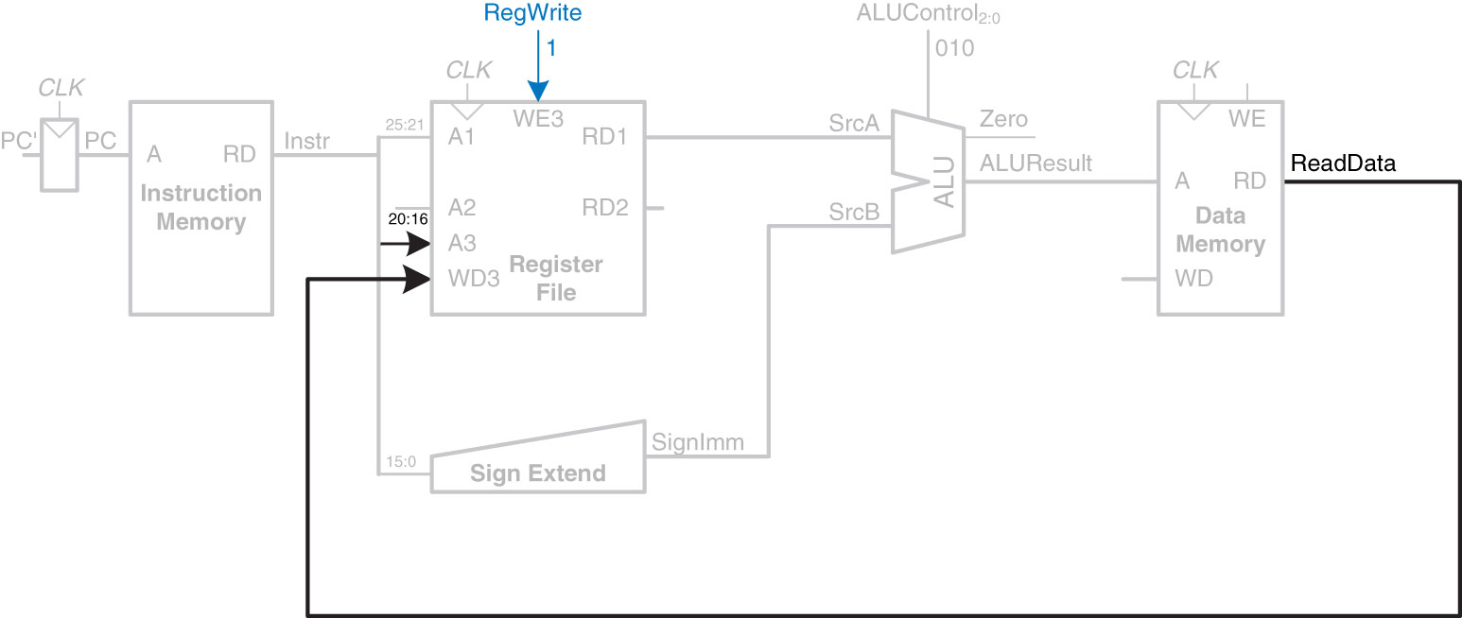
I-Type Instruction
lw rt, imm(rs)
Step 5:
I-Type
op | rs | rt | imm
6 bits | 5 bits | 5 bits | 16 bits
31:26 | 25:21 | 20:16 | 15:0
Figure 7.6 Write data back to register file
Copyright © 2013 Elsevier Inc. All rights reserved.

Slide 26
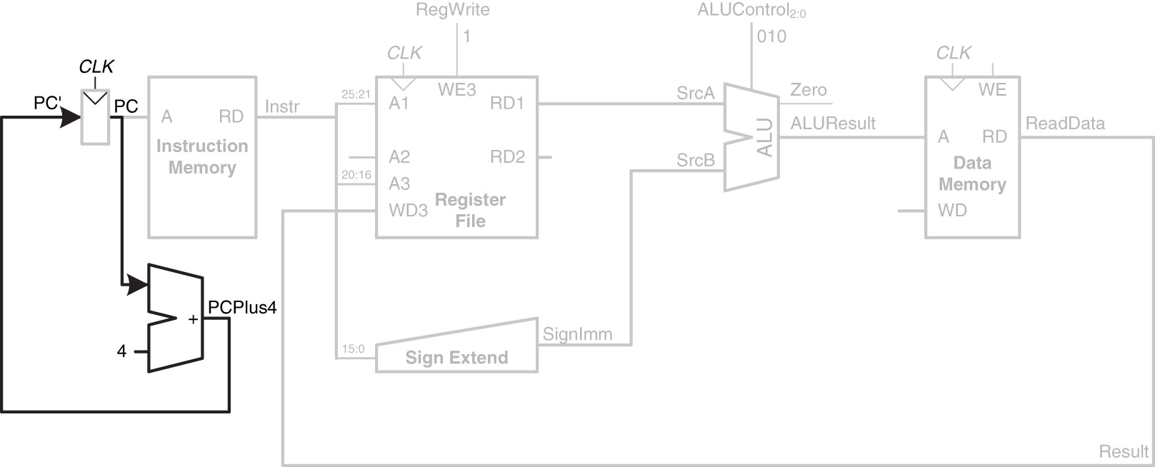
Determine address of next Instruction for PC
Step 6:
I-Type
op | rs | rt | imm
6 bits | 5 bits | 5 bits | 16 bits
31:26 | 25:21 | 20:16 | 15:0
Figure 7.7 Determine address of next instruction for PC
Copyright © 2013 Elsevier Inc. All rights reserved.

Slide 27
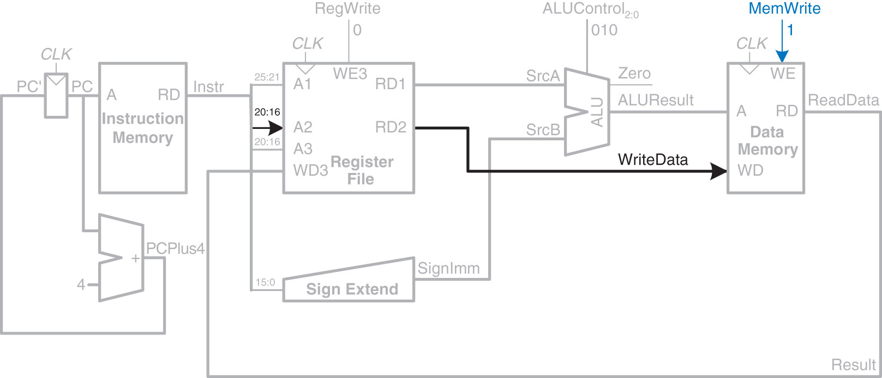
I-Type Instruction
Enhancements for SW
I-Type
op | rs | rt | imm
6 bits | 5 bits | 5 bits | 16 bits
31:26 | 25:21 | 20:16 | 15:0
Figure 7.8 Write data to memory for sw instruction
Copyright © 2013 Elsevier Inc. All rights reserved.

Slide 28
R-Type Instructions
R-Type Instructions – Register Type
R-Type
op | rs | rt | rd | shamt | funct
6 bits | 5 bits | 5 bits | 5 bits | 5 bits | 6 bits
31:26 | 25:21 | 20:16 | 15:11 | 10:6 | 5:0
R-Type
op | rs | rt | rd | shamt | funct
6 bits | 5 bits | 5 bits | 5 bits | 5 bits | 6 bits

Slide 29
R-Type Instructions add rd, rs, rt
R-Type
op | rs | rt | rd | shamt | funct
6 bits | 5 bits | 5 bits | 5 bits | 5 bits | 6 bits
31:26 | 25:21 | 20:16 | 15:11 | 10:6 | 5:0

Slide 30
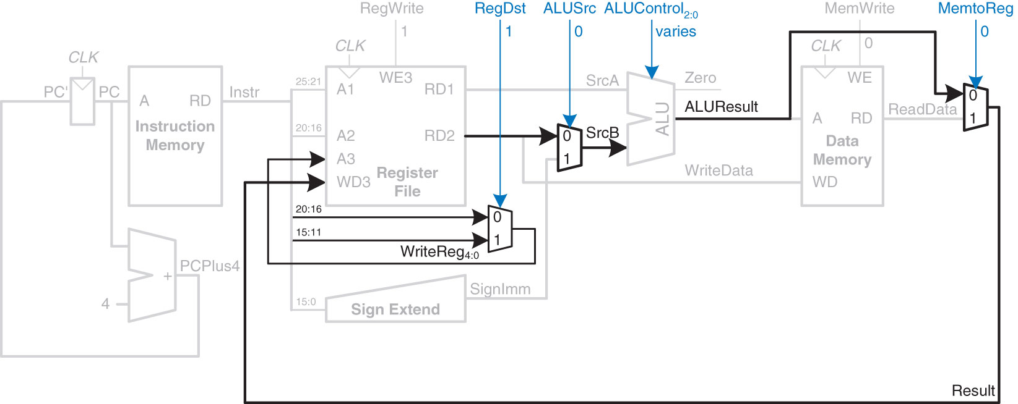
Datapath Enhancements for
R-Type Instruction
Figure 7.9 Datapath enhancements for R-type instruction
Steps for R-Type Instructions
(ex ADD: add rd, rs, rt):
Read 2 Registers
Do ALU Op
Write/Register
Add a Destination
R-Type
op | rs | rt | rd | shamt | funct
6 bits | 5 bits | 5 bits | 5 bits | 5 bits | 6 bits
31:26 | 25:21 | 20:16 | 15:11 | 10:6 | 5:0
Copyright © 2013 Elsevier Inc. All rights reserved.

Slide 31
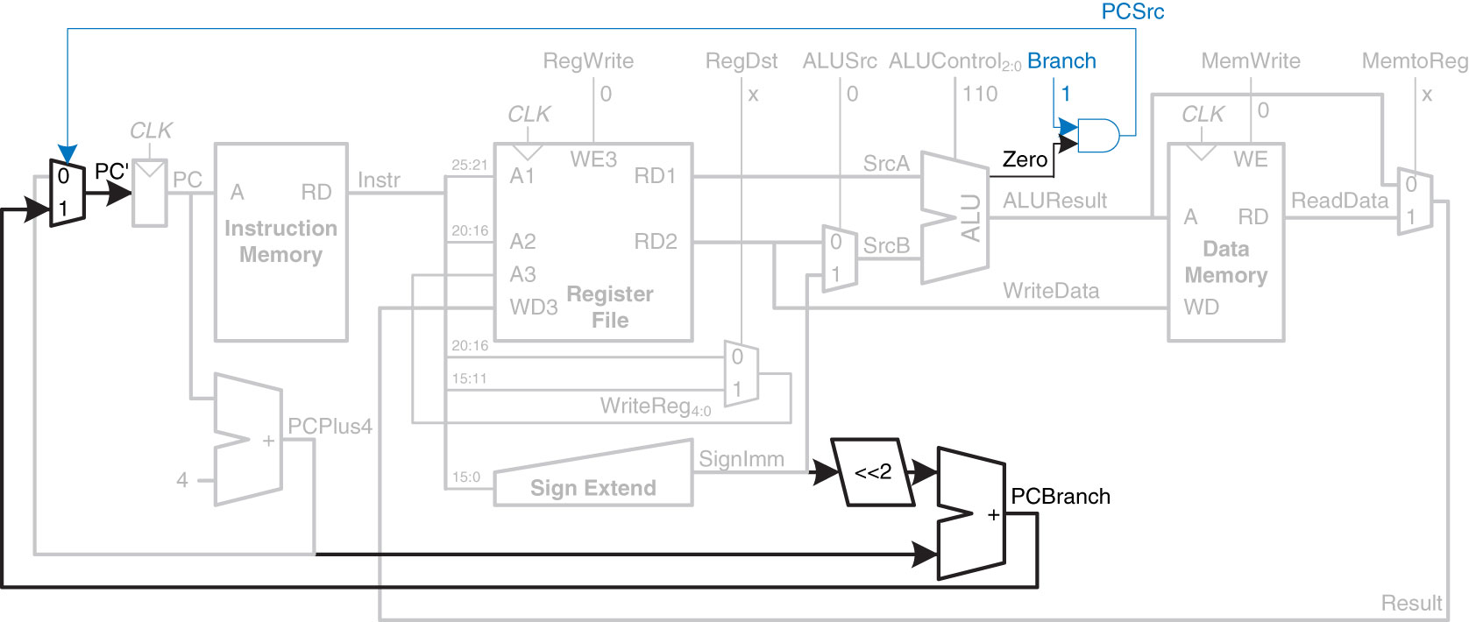
Datapath Enhancements for
BEQ Instruction
Figure 7.10 Datapath enhancements for beq instruction
Copyright © 2013 Elsevier Inc. All rights reserved.

Slide 32
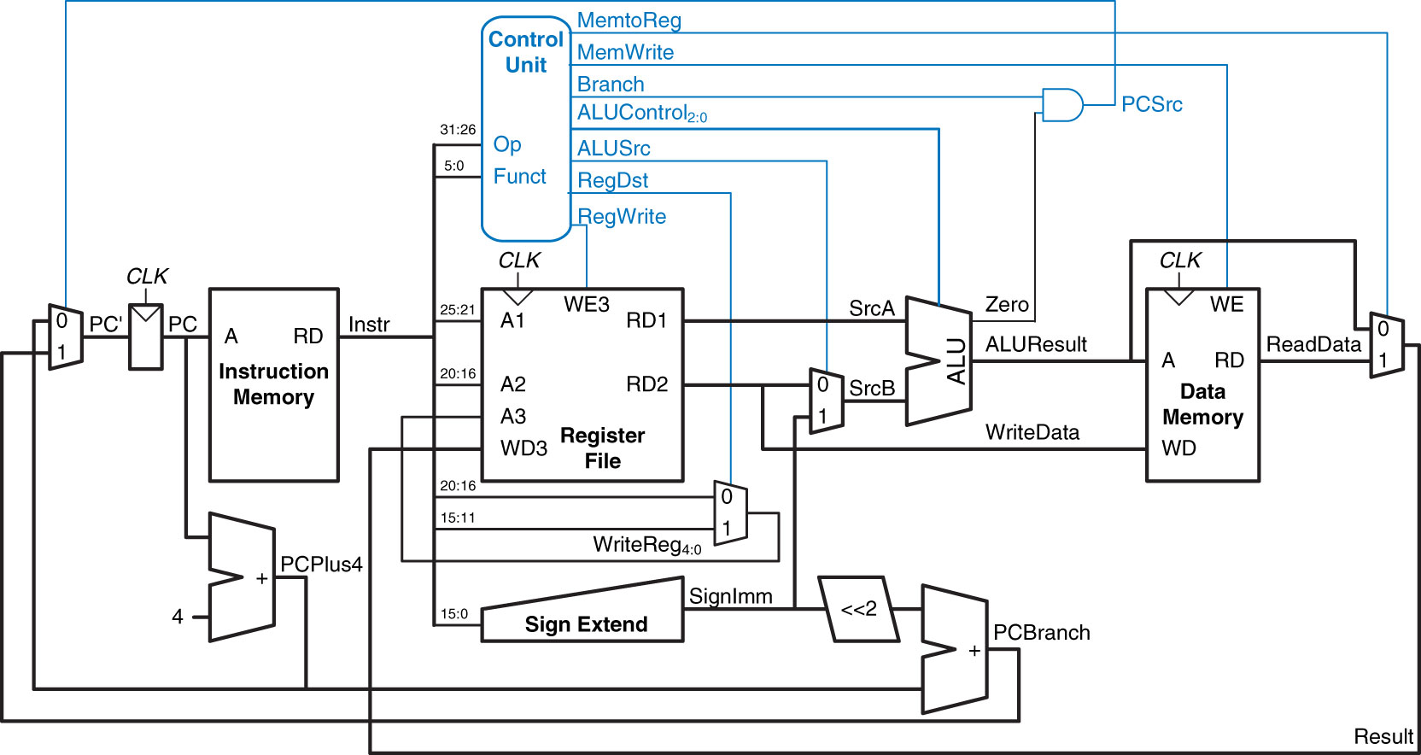
Complete Single-Cycle MIPS Processor
Control Unit – This Lesson
Figure 7.11 Complete single-cycle MIPS processor
Copyright © 2013 Elsevier Inc. All rights reserved.

Slide 33
J-Type Instructions
J-Type Instructions – Register Type
J-Type
op | addr
6 bits | 26 bits
31:26 | 25:0

Slide 34
Extended Functionality: j
Copyright © 2013 Elsevier Inc. All rights reserved.

Slide 35
Extended Functionality: j
Copyright © 2013 Elsevier Inc. All rights reserved.

Slide 36
MIPS Single-Cycle Processor
Control Unit – This Lesson

Slide 37
Control Unit
Controller has two parts:
Main Decoder
Takes opcode and generates control signal
Also generates ALUOp_{1:0} signal to give to ALUDecoder
ALU Decoder –
Fed by ALUOp_{1:0} signal
with Funct_{5:0} tells ALU the appropriate ALUControl_{2:0} signal
2 Decoders tied together by 2 bit ALUOp signal
Copyright © 2013 Elsevier Inc. All rights reserved.

Slide 38
Control Unit
Our Controller (currently) outputs 6 signals:
Reg_Write – are we writing to a register?
Reg_Dst – 0 for I-Type, 1 for R-Type
ALU_Src – 1 for I-Type, 0 for R-Type (generally)
Branch – are we branching?
Mem_Write – are we writing to memory?
Mem_to_Reg – are we moving info from memory to a register?
Controller has two inputs:
Opcode_{5:0}
Funct_{5:0}

Slide 39
MIPS Single-Cycle Processor

Slide 40
Single-Cycle Datapath
Example: OR
Copyright © 2013 Elsevier Inc. All rights reserved.

Slide 41
Wrap up
What is the Difference between OR and ORI?
ORI is a logical operation (i.e. it does not sign extend)…it zero extends from 16 ➔ 32-Bits
OR is also an R-Type instruction
ADDI is a math operation and does use sign extended immediate
When talking about muxes we can safely say Don’t Care (i.e. ‘X’). Memory is not one of them.
The Key is keeping control of your control signals!

Slide 42
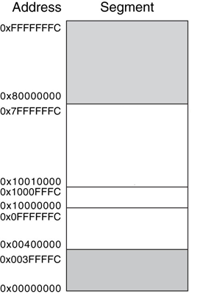
MIPS Memory Map
Reserved
Stack
$sp = 0x7FFFFFFC
Dynamic Data
Heap
Global Data
$gp = 0x10008000
Text
PC = 0x00400000
Reserved
Figure 6.31 MIPS memory map

Slide 43
Steps for Translating and starting a program
Higher Level Language (HLL)
Compiler
Assembly Language
Assembler
Object File (Machine Code)
Object Files
Library Files
Linker
Executable
Loader
Memory

Slide 44
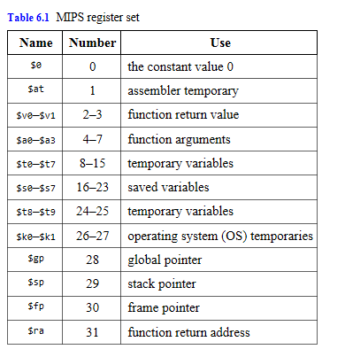
MIPS Register Set
Copyright © 2013 Elsevier Inc. All rights reserved.

Slide 45
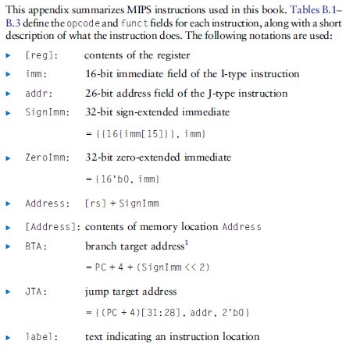
MIPS Instruction Set
Copyright © 2013 Elsevier Inc. All rights reserved.

Slide 46
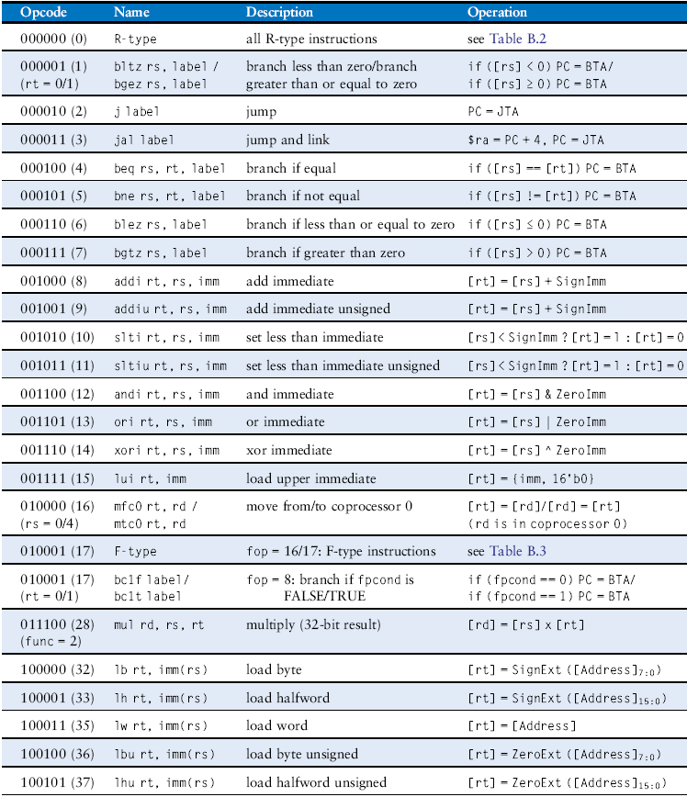
MIPS Instruction Set
Table B.1 Instructions, sorted by opcode
Copyright © 2013 Elsevier Inc. All rights reserved.

Slide 47
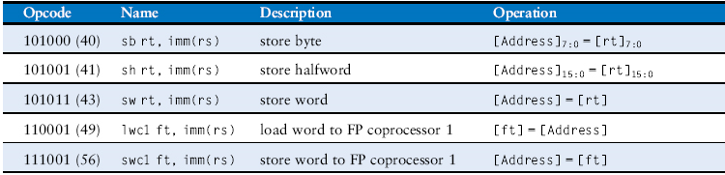
MIPS Instruction Set
Table B.1 Instructions, sorted by opcode
Copyright © 2013 Elsevier Inc. All rights reserved.

Slide 48
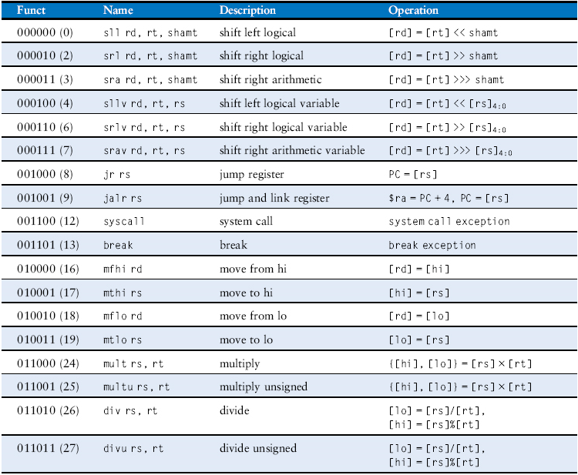
MIPS Instruction Set
Table B.2 R-type instructions, sorted by funct field
Copyright © 2013 Elsevier Inc. All rights reserved.

Slide 49
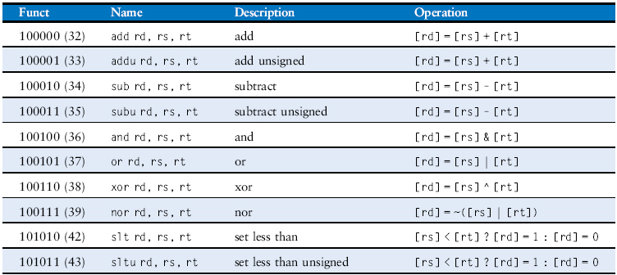
MIPS Instruction Set
Table B.2 R-type instructions, sorted by funct field
Copyright © 2013 Elsevier Inc. All rights reserved.

Slide 50
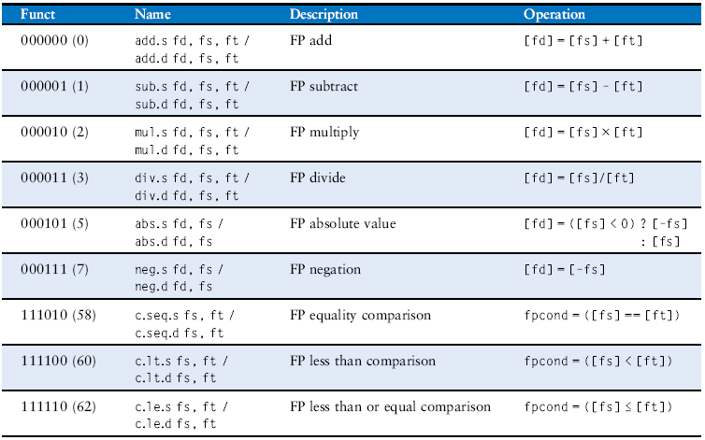
MIPS Instruction Set
Table B.3 F-type instructions (fop = 16/17)
Copyright © 2013 Elsevier Inc. All rights reserved.

Slide 51
Extra Instruction (EI)
Maj Jeffrey Falkinburg
2E46E
Office: 333-9193
M1
ECE 281 – 2F44
T1
M2
ECE 281 – 2F44
T2
M3
ECE 463 – 2G2
T3
ECE 383 – 2E48A
M4
ECE 463 – 2G2
T4
ECE 383 – 2E48A
Available
M5
T5
Sometimes Available
M6
ECE 383 – 2E48A
T6
Always Unavailable
M7
ECE 383 – 2E48A
T7

Slide 52

52

